Slide 1
Identification of Dyslexia From EEG Signals Using Deep Learning
Marsha Binti Mohamad Muhsin – 1171101715
Supervisor – Dr Vijayakumar
Moderator – Dr Joseph Sheela Francisca

Slide 2
Introduction
To this day, number of dyslexics that were not diagnosed are still on the rise
Researchers are looking into connecting dyslexia with brain wave patterns in order to find a way to diagnose dyslexia. The most common one uses a type of brain signal called electroencephalography (EEG)
Problem Statement
EEG is generally too large to be clean by a person
EEG data is hard to be interpreted
Finding patterns from the EEG data that can help identify the dyslexia

Slide 3
Introduction
Objectives
Obtain and clean the EEG data
Design a system that can automatically clean and produce time-frequency images from raw EEG data
Design and implement deep learning framework for the identification of dyslexia

Slide 4
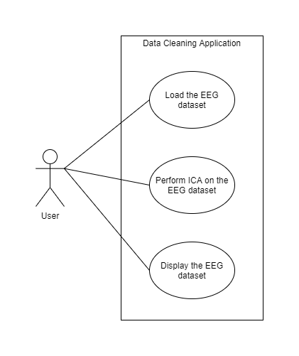
Preprocessing EEG Data
The cleaning process is long and tedious.
Therefore, a MATLAB application is created to semi-automate the process.
The use case of the application is shown below:

Slide 5
MATLAB Application Demonstration

Slide 6
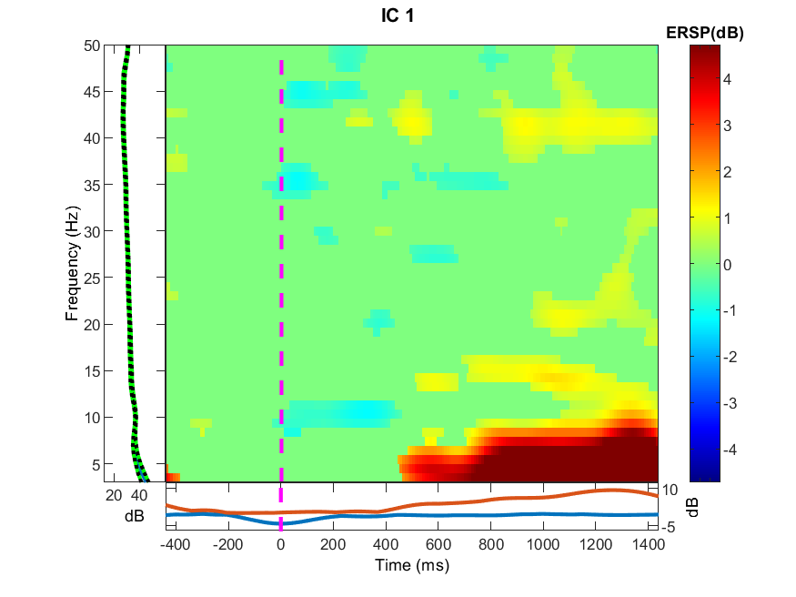
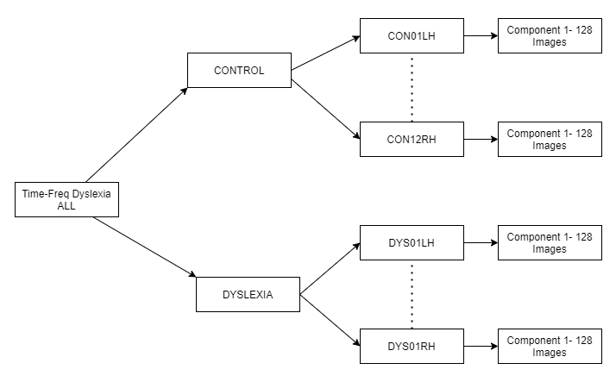
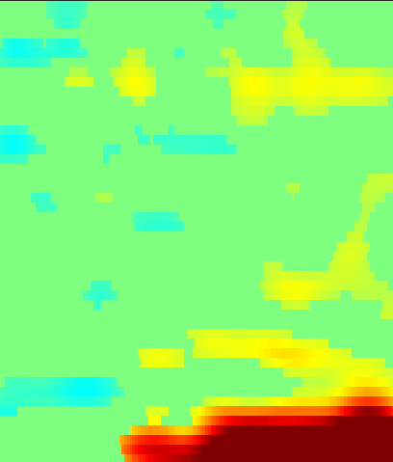
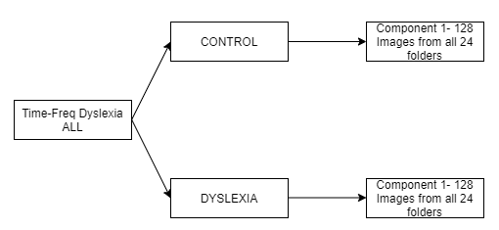
Preprocessing EEG Data
The images that we retrieved after the cleaning process had some unnecessary details and need to be removed.
At the same time, the folder structure need to be created to serve as a pipeline for the deep learning framework.
Therefore a python script is created to achieve these two goals.

Slide 7
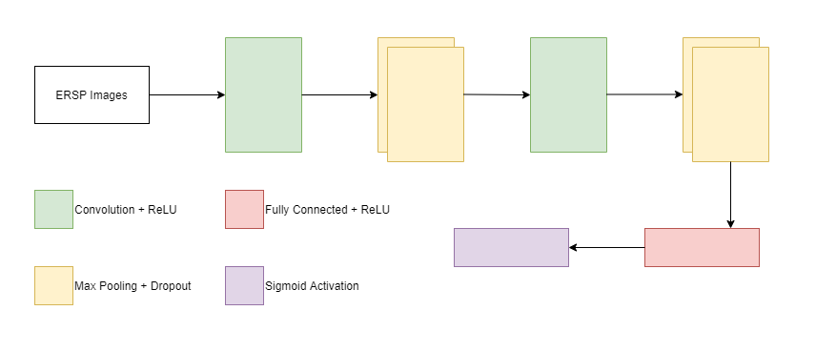
Deep Learning Framework
The model was created using Convolution Neural Network framework.

Slide 8
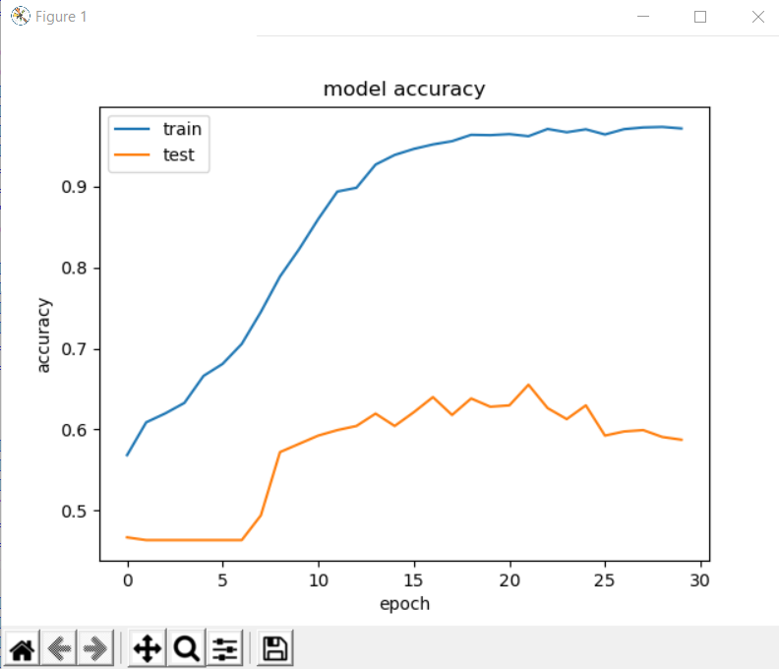
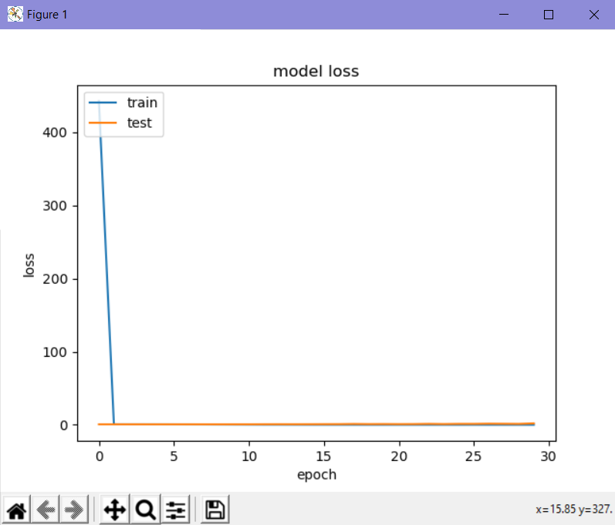
Results

Slide 9
Thank You

